Slide 1
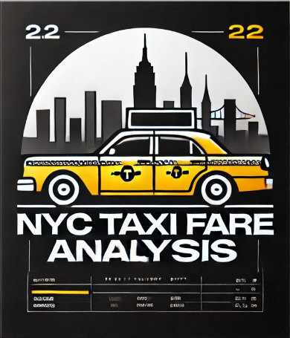
NYC Taxi Fare Analysis Using Big Data Tools
Presented By:
Vaishnavi Samboji Parag Deshpande
Catherine Raj
Group 7

Slide 2
Research Problem
The unpredictable nature of taxi fares creates challenges for passengers and drivers in budgeting and planning.
Our project aims to analyze fare patterns using PySpark and build a predictive model to estimate taxi fares accurately and perform visualizations on PowerBI.
Tools Used In Our Project
PySpark - For processing 13M records
Hive - SQL Queries for Visualizing Data
MLLib - Building regression model for fare prediction
Google BigQuery
PowerBI

Slide 3
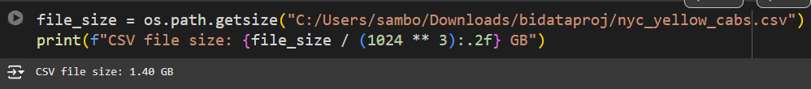
Requirement Analysis
Source of data: Open Source NYC Yellow Taxi Trip Record Data
https://www.nyc.gov/site/tlc/about/tlc-trip-record-data.page
We have aggregated data collected from the previous 4 months
(June 2024, July 2024, Aug 2024, Sept 2024)
Dataset Size: 1.40 GB (13M Records)
Project satisfies the Volume aspect
Usage of big data tools like PySpark, Hive and MLLib

Slide 4
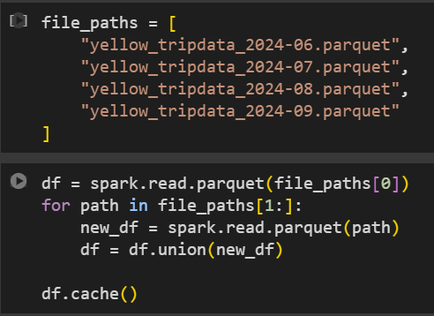
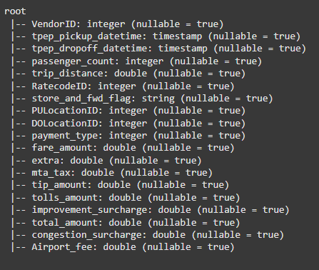
Exploratory Data Analysis Using PySpark - Basic EDA
spark.read.parquet()
Loading the parquet files
df.printSchema()
To get column names - 19 Columns
df.show(5) - To print top 5 rows of the data

Slide 5
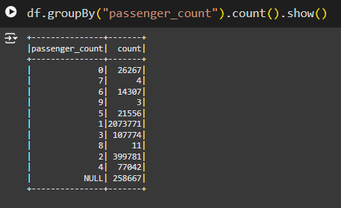
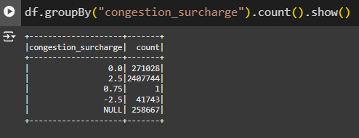
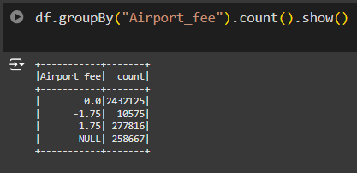
EDA - Usage of aggregation functions - count()
df.groupBy(): Get count of passengers who have taken a ride in the past 4 months
Count of rides which were charged higher due to traffic congestion
Count of passengers travelling to the airport which are grouped by extra fee charged

Slide 6
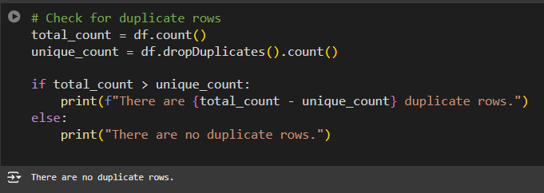
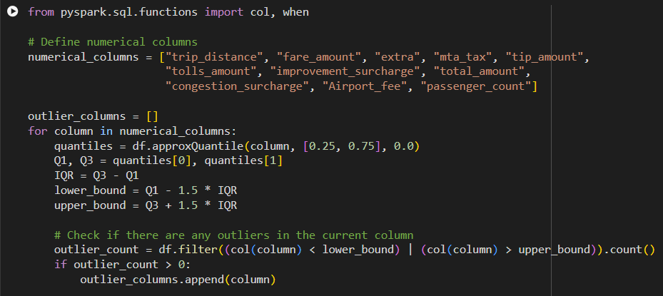
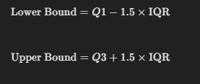
EDA - Outlier handling and removing duplicate rows
Checking for duplicate rows:
No duplicate rows were found
Outlier Analysis using IQR method
Data points are considered if it ranges between these values
The following columns had outliers - trip_distance, fare_amount, extra, mta_tax, trip_amount, tolls_amount, imporovement_surcharge, total_amount, congestion_surcharge, Airport_fee, passenger_count (8 Columns)

Slide 7
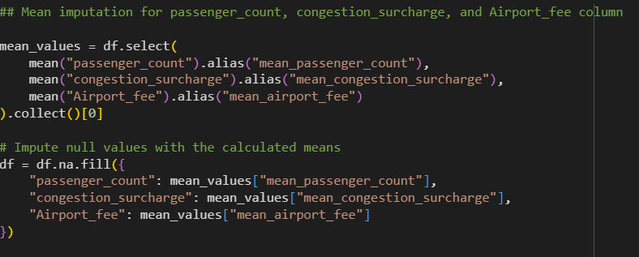
Preprocessing
We have dropped 2 columns (RatecodeID, store_flag) due to high cardinality using the df.na.drop() function
Performed mean imputation for columns with missing values using df.na.fill()
Removed the outlier values using df.()filter function

Slide 8


Feature Engineering
Need for feature engineering: We figured a lot of the data required for predicting fares could be derived from the existing data itself which could help our model make accurate predictions
Calculated trip_duration in minutes for each ride
Few other features like
distance_per_passenger - Distance travelled by each passengers
fare_per_distance - Fare charged for each mile travelled
total_per_passenger - Amount charged for each passenger in a ride
Average fare charged based on location using agg() function

Slide 9
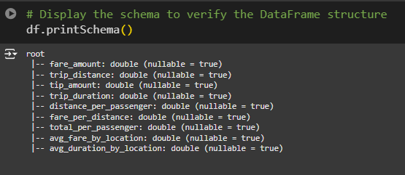
Statistical Analysis - Correlation
Here we are checking linear correlation of features with our target feature (fare amount) and considering only the top 8 features for model training
We have used df.stat.corr() function to get correlation of each feature with our target feature
Based on linear correlation obtained these were the columns we selected to build a regression model using MLLib library
Note that all the features are numerical and we have used the features which were engineered

Slide 10

Regression Using MLLib Library
Used vector assembler to get all the descriptive features in a single vector
Performed feature normalization using StandardScaler
Performed Linear Regression
Evaluated model using RMSE values: Obtained a RMSE value of 0.92 with an error rate of 7.38%

Slide 11
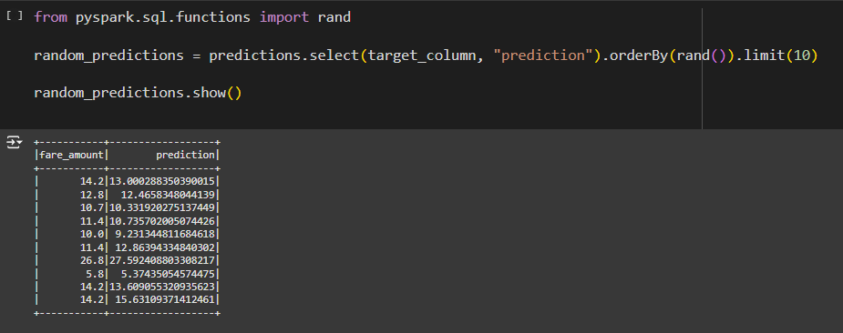
Visualizing Sample Predictions
Here we are visualizing a random set of values of predicted fare amount by our model vs the actual fare amount. As you can see there is not a lot of difference between the values. Hence we can infer that out model is accurately predicting the fare amount

Slide 12
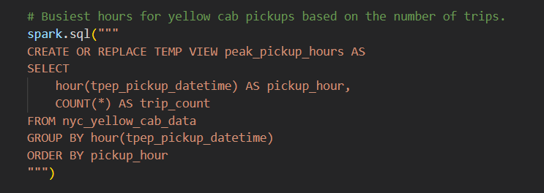
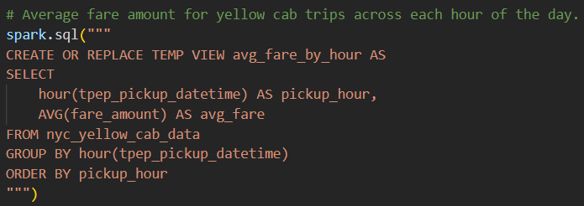
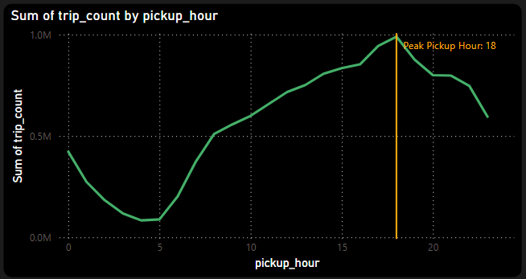
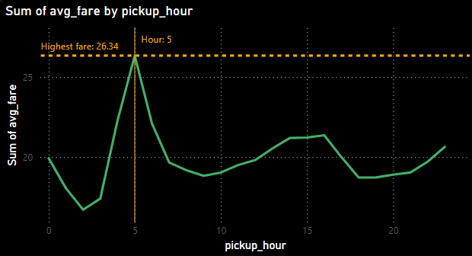
Visualizations Made Using Hive
Hourly Analysis:

Slide 13
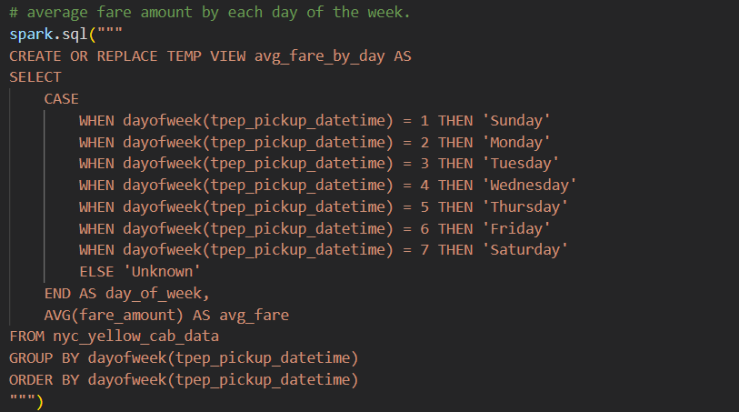
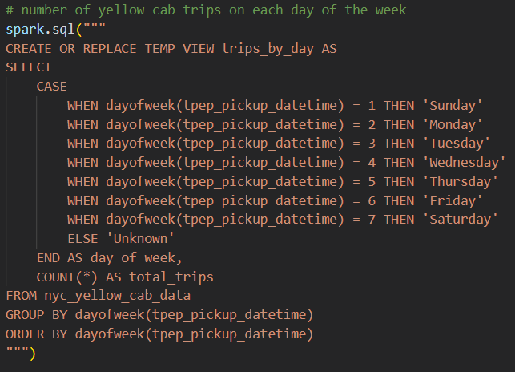
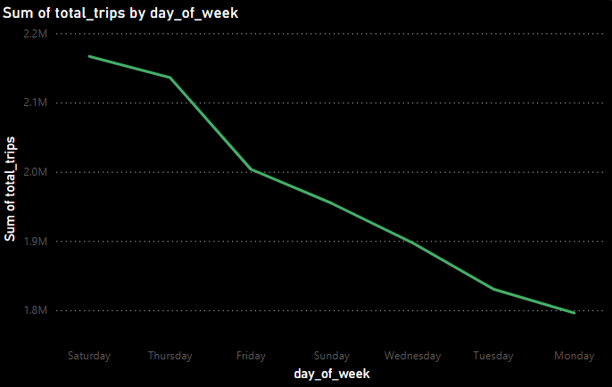
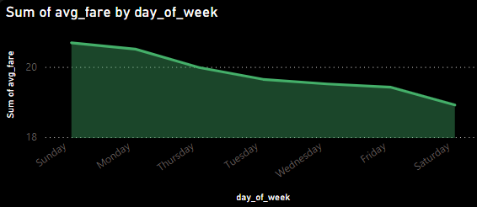
Visualizations Made Using Hive
2. Weekly Analysis:

Slide 14
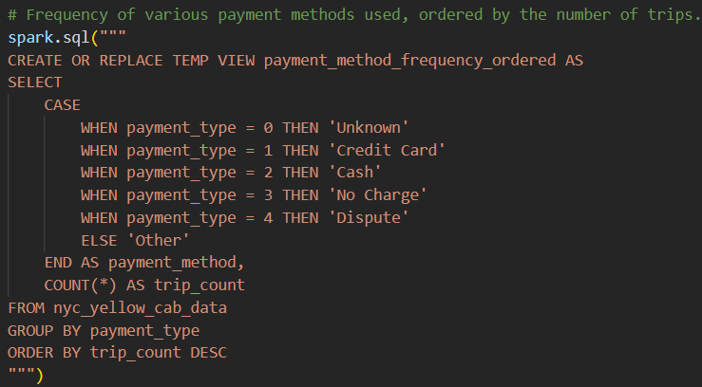
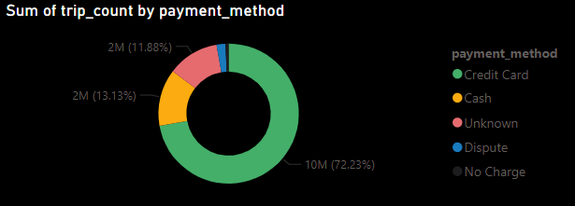
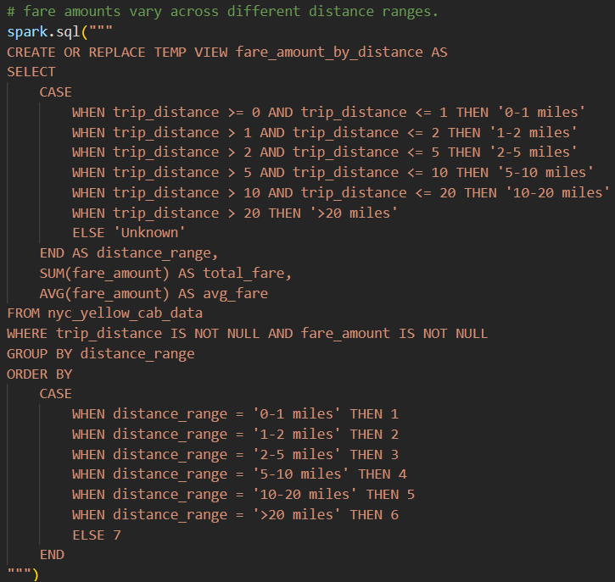
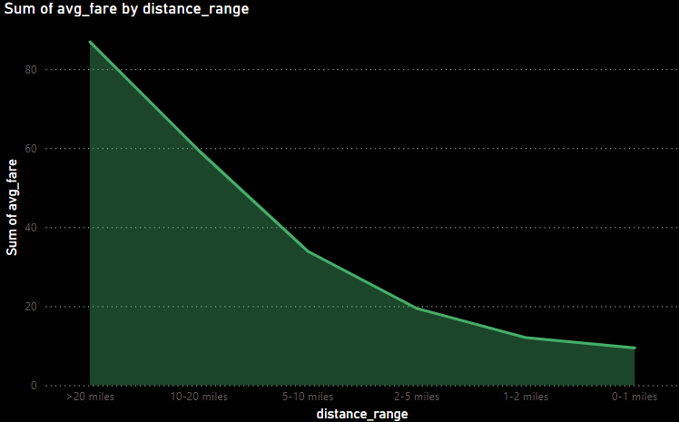
Visualizations Made Using Hive
3. Revenue Analysis:

Slide 15
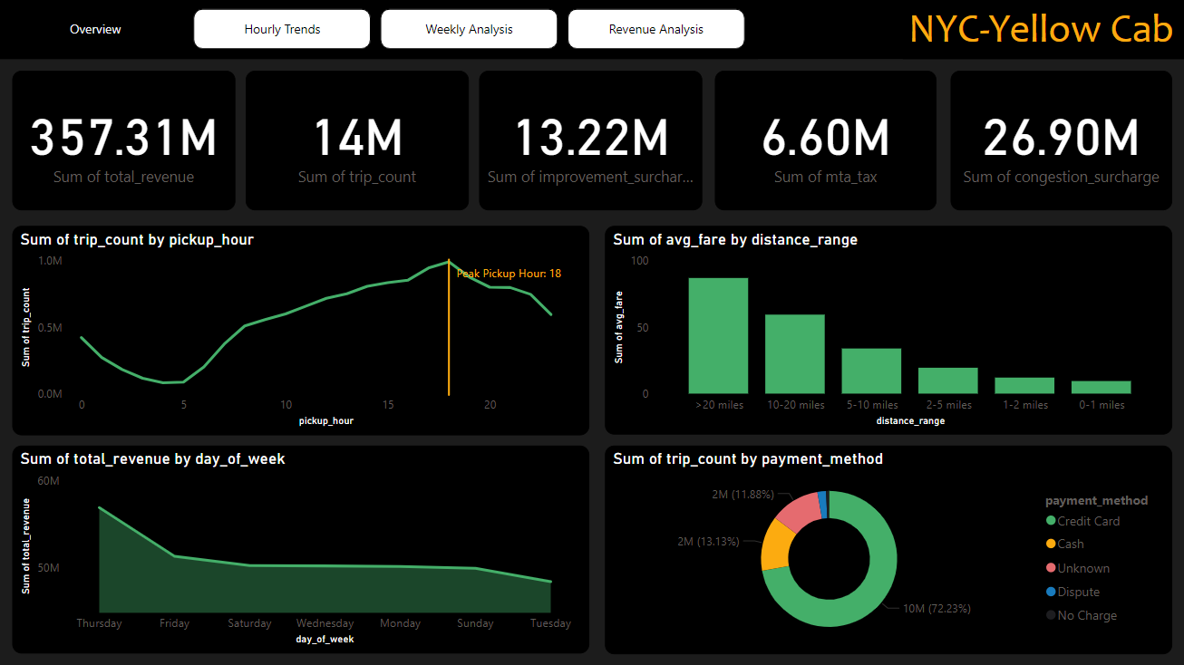
Dashboard Overview
This Dashboard provides clear insights into trip patterns, revenue trends, and payment methods, enabling data-driven decisions to optimize taxi operations and improve customer experience.

Slide 16
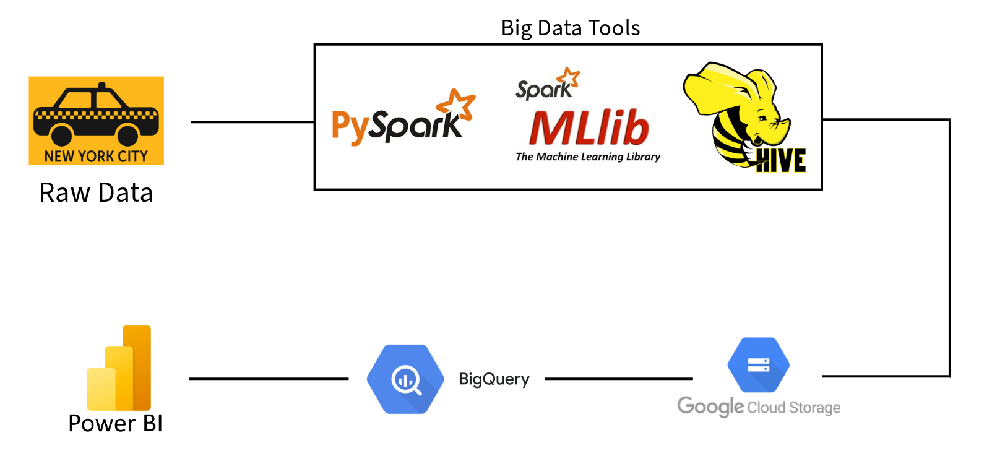
Workflow

Slide 17
Power Bi Dashboard Link
https://sjsu0-my.sharepoint.com/:u:/g/personal/vaishnavi_samboji_sjsu_edu/ER8puFBKVuRLnLR8TVb5EcoB2dd5GQOgvUG_XHGtU4RcgA

Slide 18
Result
The model had an RMSE of 0.93 and an error percentage of 7.38% indicating high accuracy
Trip distance seemed to have the highest impact on fare prediction
Visual analysis showed a strong alignment with actual values and predicted values
Derived and aggregated features captured and summarized patterns to enhance the model

Slide 19
Conclusion
Use of Big Data tools allowed for through analysis and accurate fare prediction
Being able to predict fares allows passengers to plan better and drivers to enhance their service
Preprocessing and feature engineering enhanced model performance
For the future it may be best to consider using more external variables such as weather,events and more to further refine the model

Slide 20
THANK
YOU

